Slide 1

Analysis of Boston housing
CIS 490 – Machine Learning
Sectional Project 1
Taha bin Amer, Pranav Vinod

Slide 2
introduction
The aim of this project is to analyze the Boston Housing dataset and apply different regression techniques to find out the most significant variables in predicting the median value of owner-occupied homes.
The Boston Housing dataset contains information collected by the U.S Census Service concerning housing in the area of Boston, Massachusetts from the 1970 census. The dataset is relatively small in size with 506 entries, and 14 attributes.
We will be employing multiple linear regression, ridge regression and lasso regression on the dataset. Lastly, we will compare and contrast the outcomes from these three regression techniques and discuss the results.

Slide 3
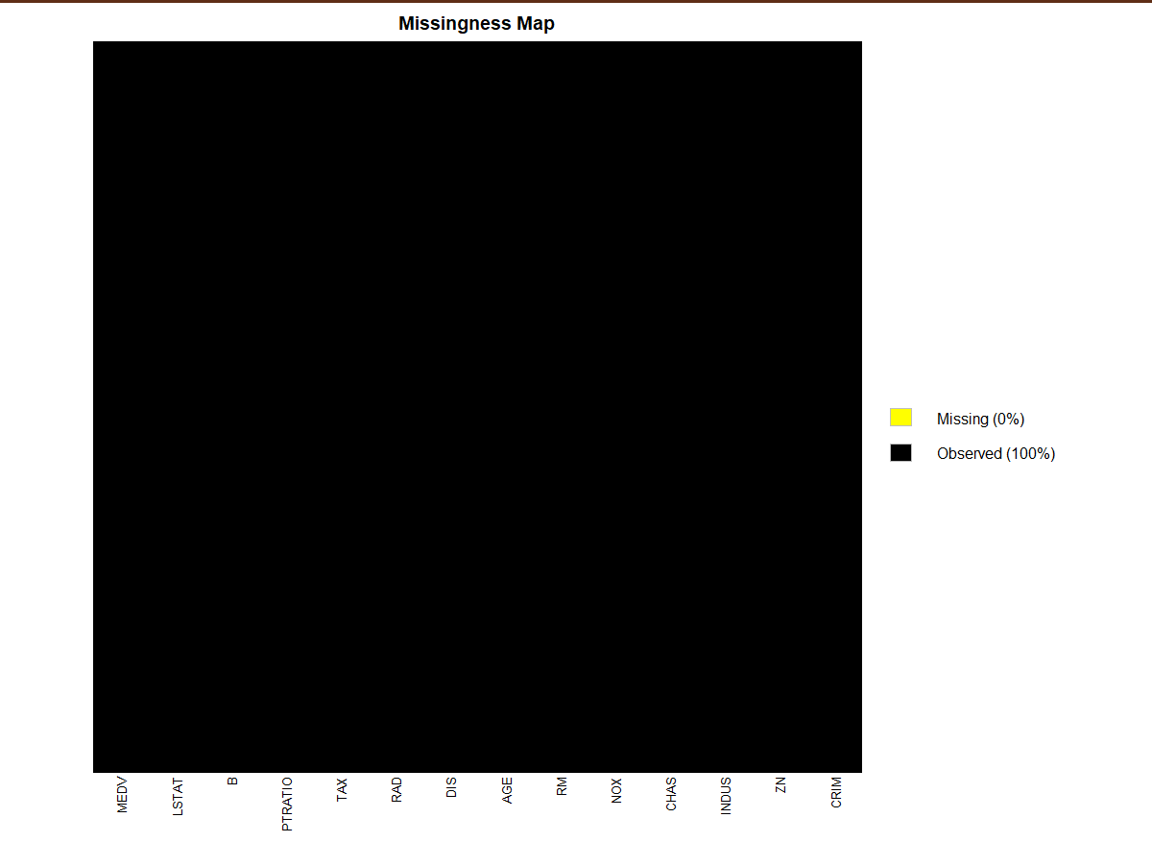
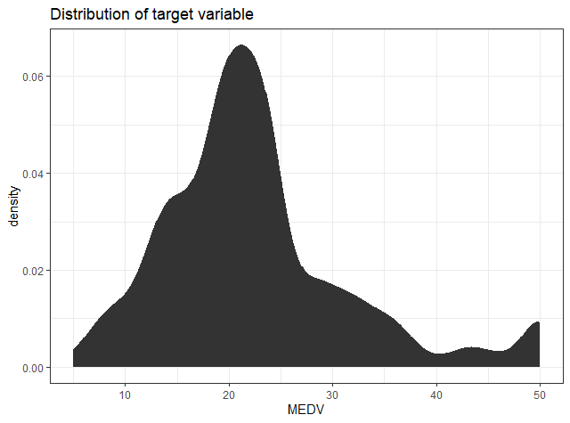
Exploratory Data Analysis

Slide 4
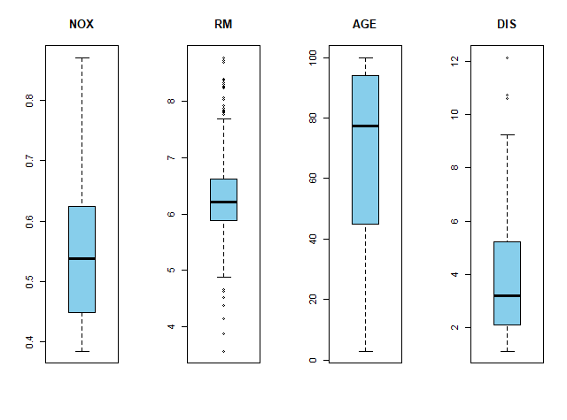
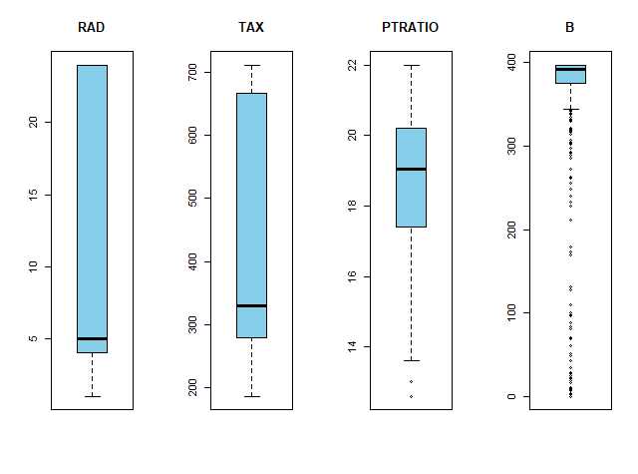
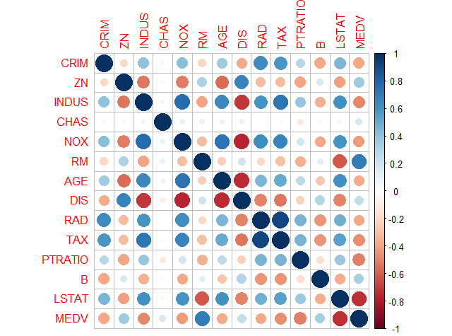
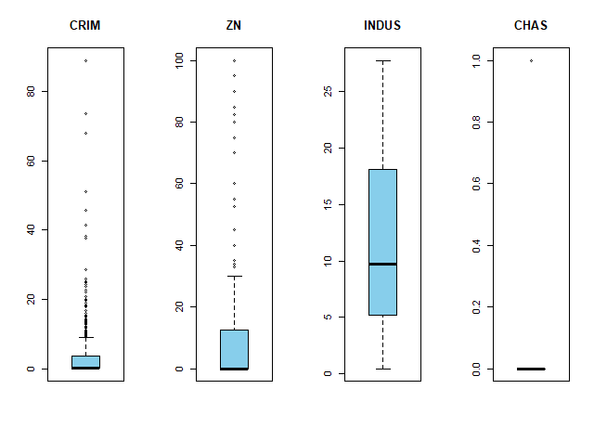
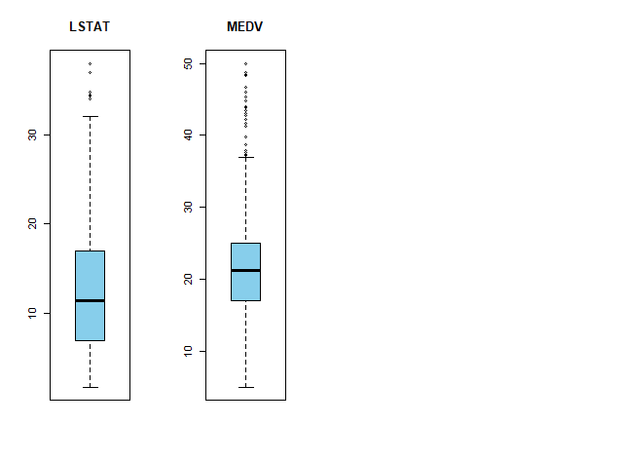
Exploratory Data Analysis (Continued)

Slide 5

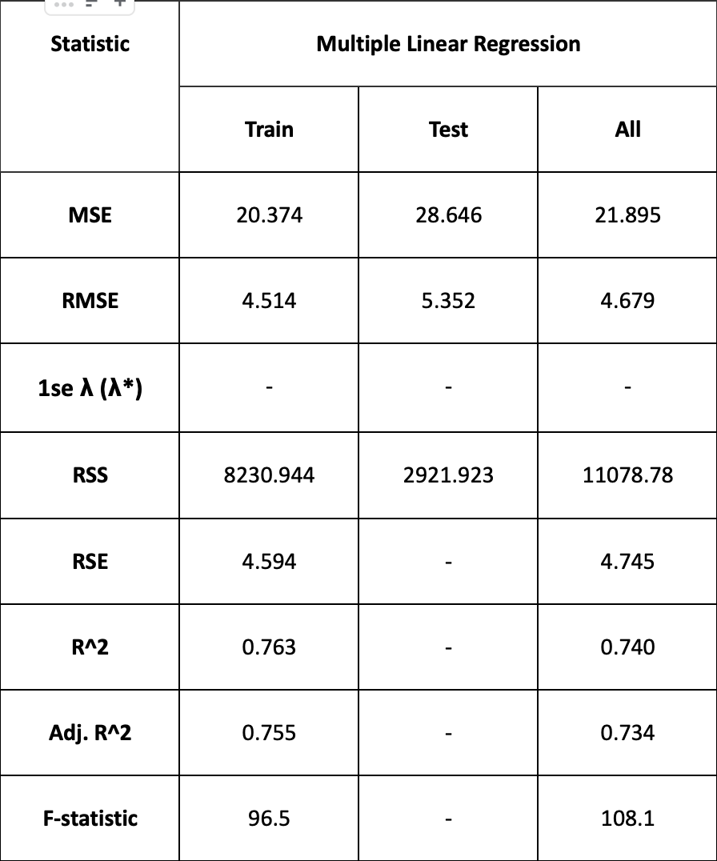
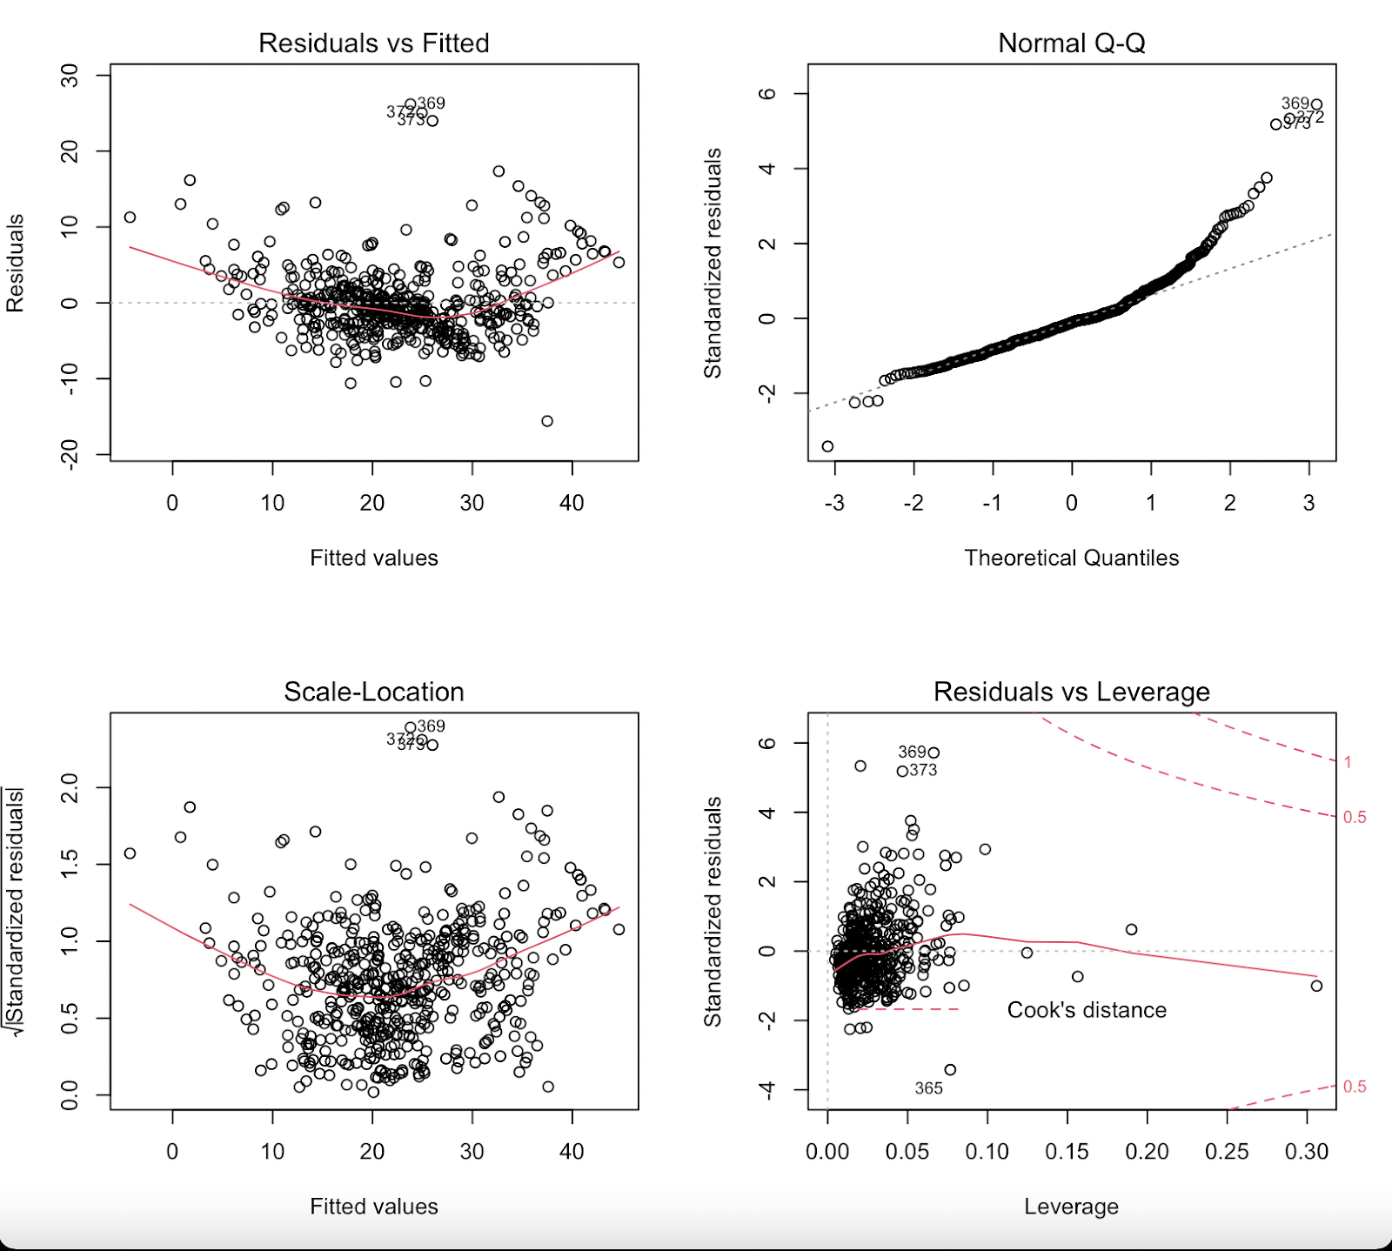
Multiple Linear Regression
Multiple Linear Regression was carried out on the dataset by dividing 80% of data into training set and the remaining into testing set.
The MSE value for model fit on training, testing and complete dataset were 20.374, 28.646 and 21.895 respectively
The final estimated model was : MEDV = 36.46-0.110*CRIM+ 0.046* ZN+0.020 * INDUS+2.678*CHAS-17.77*NOX+3.810*RM +0.0007*AGE-1.476*DIS+0.306*RAD-0.012*TAX-0.952*PTRATIO+0.009*B -0.525*LSTAT

Slide 6
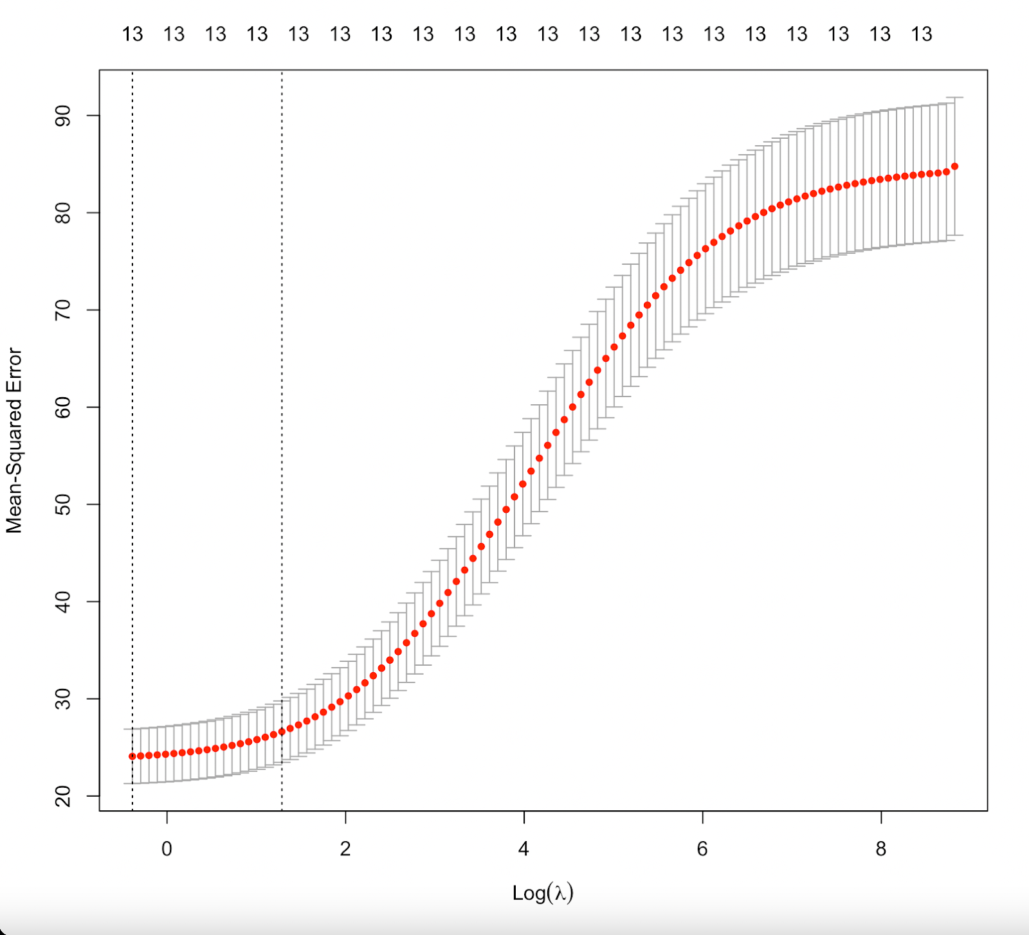
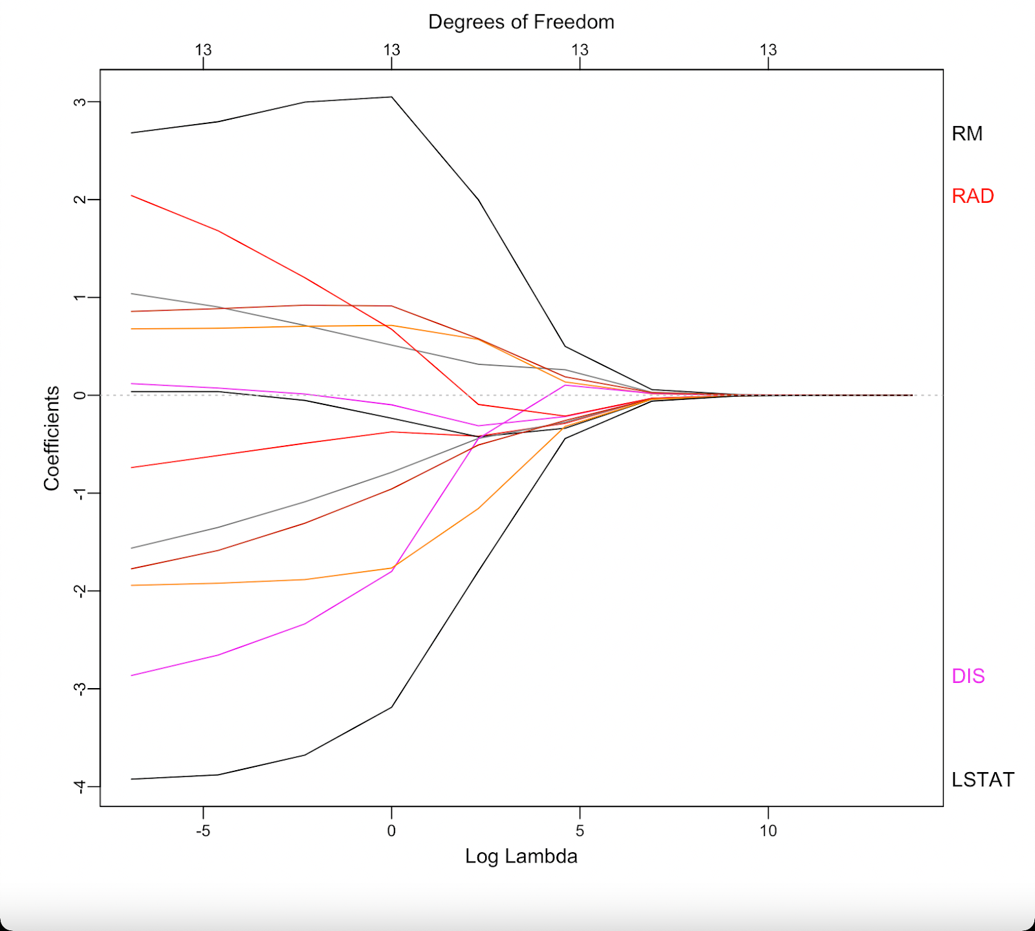
Ridge Regression
Ridge regression is technique to solve the problem of overfitting by imposing a penalty on the model and shrinking coefficients towards zero.
The most optimal λ value = 3.617
MEDV = 22.533-0.425*CRIM+ 0.275* ZN-0.408 * INDUS+0720*CHAS-0.793*NOX+2.754*RM -0.424*AGE-1.133*DIS+0.233*RAD-0.512*TAX-1.537*PTRATIO+0.745*B -2.386*LSTAT
MSE = 25.551 and RMSE=5.055 rounded off to 3 decimal places.

Slide 7
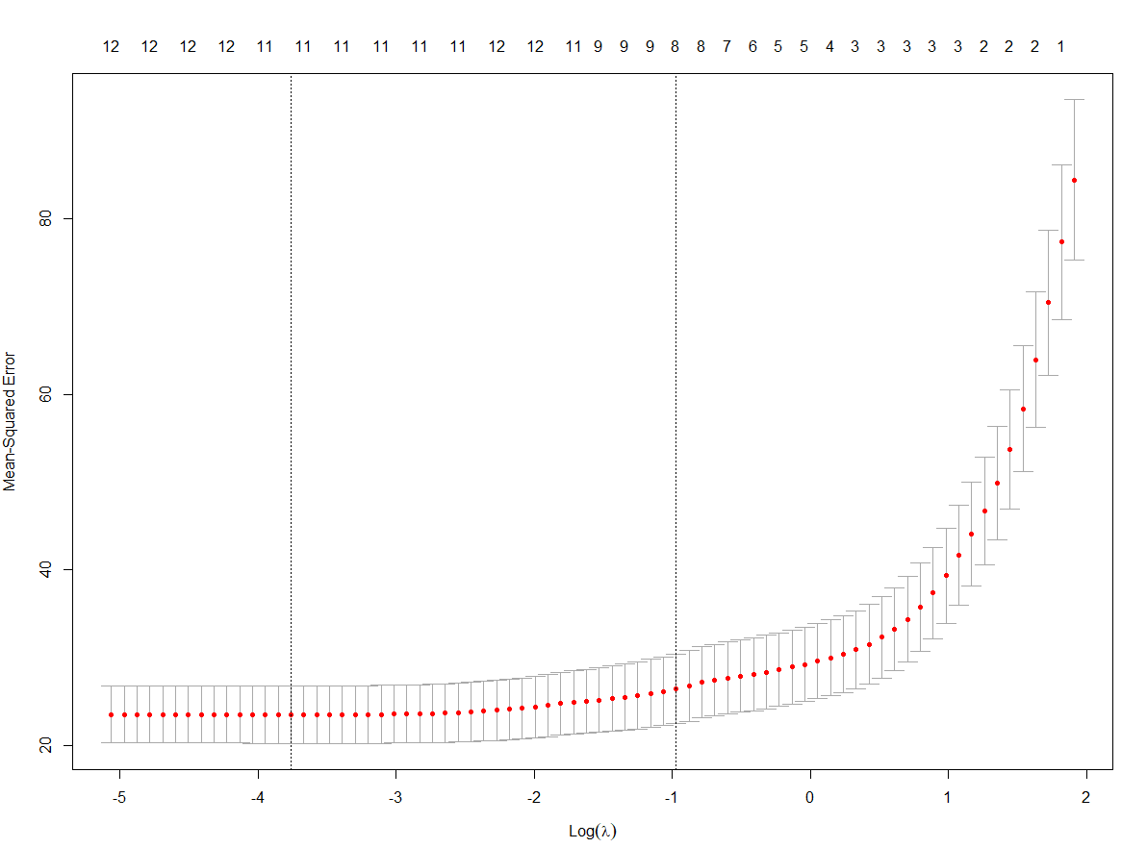
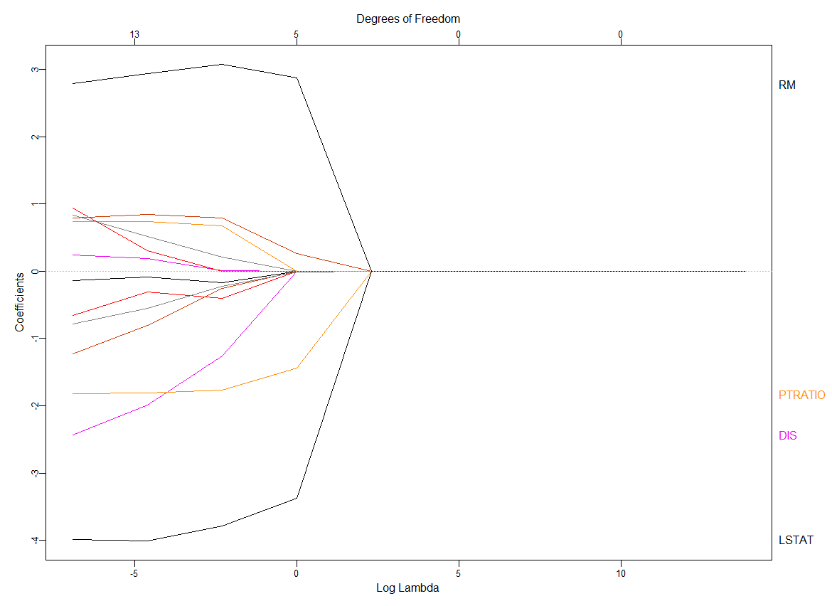
Lasso Regression
Lasso regression is a technique used to solve the problem of overfitting caused by collinearity. It basically shrinks regression coefficients with some shrunk to zero. Thus, it also helps with feature selection.
The most optimal λ value = 0.3789
MEDV = 22.533-0.175*CRIM-0.738 * INDUS+0.509*CHAS -0.332*NOX+3.616*RM-0.348*AGE -0.837*DIS-0.026*TAX -1.640*PTRATIO+0.740*B -2.744*LSTAT
MSE = 25.170 and RMSE=5.017 rounded off to 3 decimal places.

Slide 8
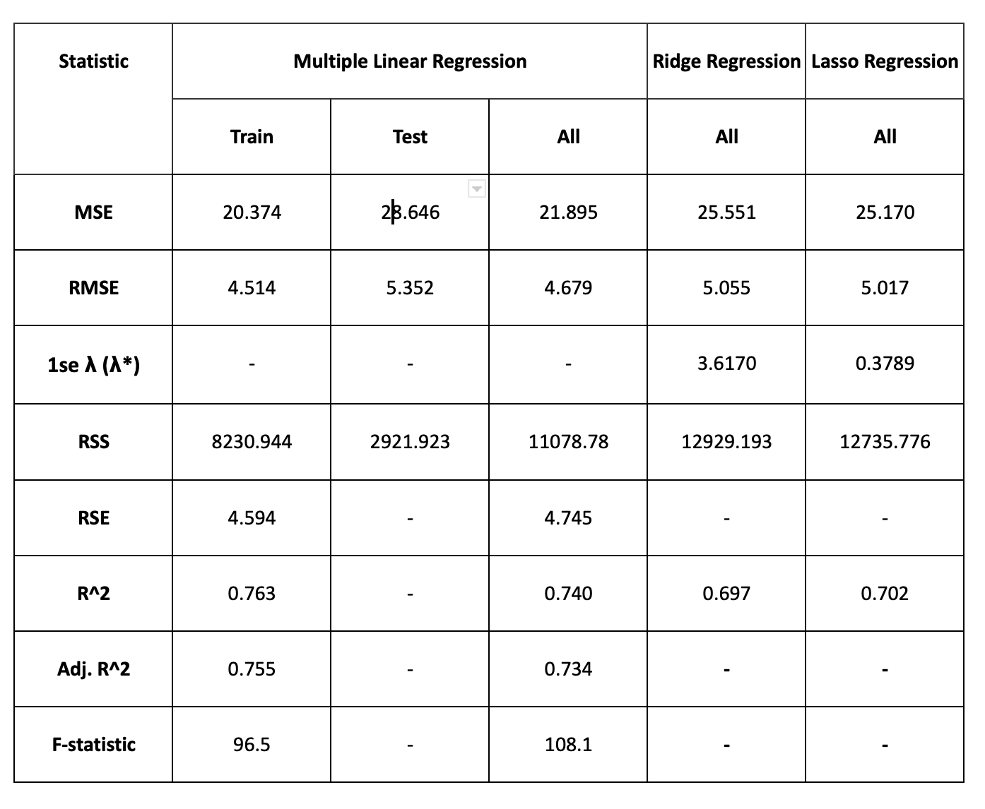
Compare all models
Upon comparing the three models, we can use accuracy estimates to compare them.
We find that multiple linear regression model has the largest value of R^2 at 0.74 followed by lasso and ridge regression.
Multiple linear regression also has the lowest value for MSE at 21.895 followed by lasso and ridge which have 25.170 and 25.551 respectively.

Slide 9
Contribution Report
Each member contributes equally.
Taha Bin Amer – 01972684
Pranav Vinod – 01984464
Group Meet and Time : Zoom – Feb 12: 10 p.m. - 11 p.m.
In person – Feb 17: 3:30 pm – 4 pm
Zoom – Feb 21: 9pm – 10pm
Zoom – Feb 22: 9pm- 10pm
Thank You!

